Slide 1
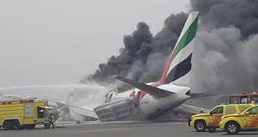
Machine Learning for Aviation Safety
Accident Trend Forecasting

Slide 2
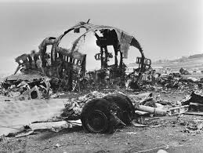
GOAL
Objective: To analyze historical aviation accident data and forecast future trends in order to support aviation safety planning and decision-making.

Slide 3
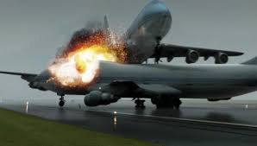
WHY IT MATTERS
Timely and accurate forecasts enable aviation authorities, airlines, and emergency services to allocate resources effectively and implement proactive safety measures.

Slide 4
Data UNDERSTANDING:
Data Source: National Transportation Safety Board (NTSB)
Timeframe: Data from 1962 to 2022, with a focus on 2000 to 2022 for this analysis.
Key Variables:
Event Date, Injury Severity, Aircraft Damage, Purpose of Flight, Weather Condition

Slide 5
Data Preparation
Filtered dataset to include only years from 2000 to 2022.
Handled missing and inconsistent data entries.
Created new features such as:
Total Injuries (fatal + serious + minor)
Categorized injury severity
Aggregated accident counts by year

Slide 6
EXPLORATORY DATA ANALYSIS(EDA):
UNIVARIATE ANALYSIS
BI-VARIATE ANALYSIS
MULTI-VARIATE ANALYSIS

Slide 7
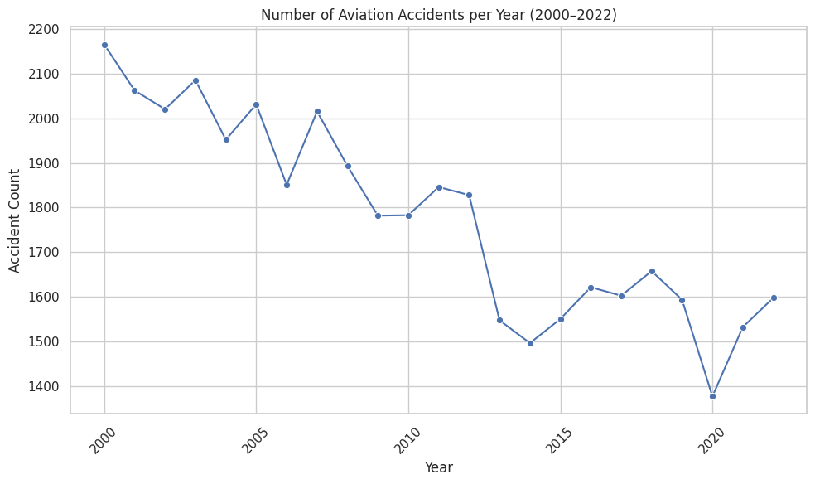
Accident trends
Observations:
There has been a general downward trend in the number of aviation accidents per year from 2000 to 2022.
There are some fluctuations year-to-year, but the overall pattern shows a decrease in accident frequency over this period.

Slide 8
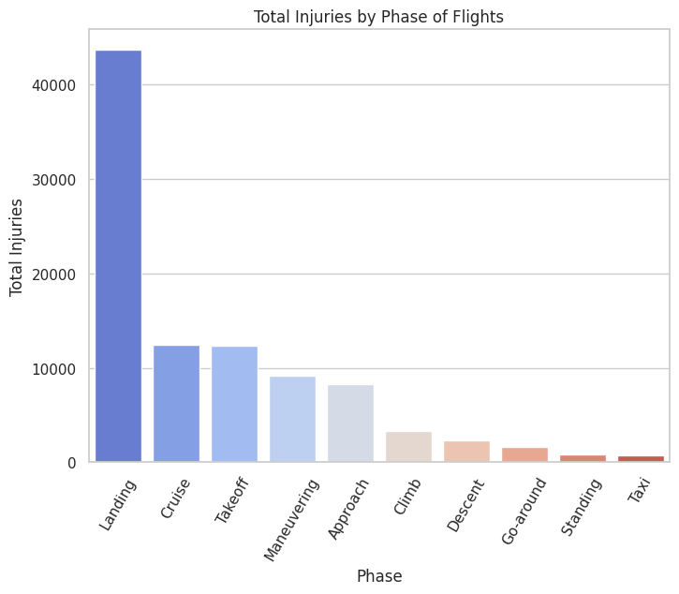
Phase of flights
Observations:
The "Landing" phase has the highest number of total injuries, closely followed by "Takeoff" and "Approach".
While the "Cruise" phase has fewer total accidents, accidents during this phase can still result in a notable number of total injuries.

Slide 9
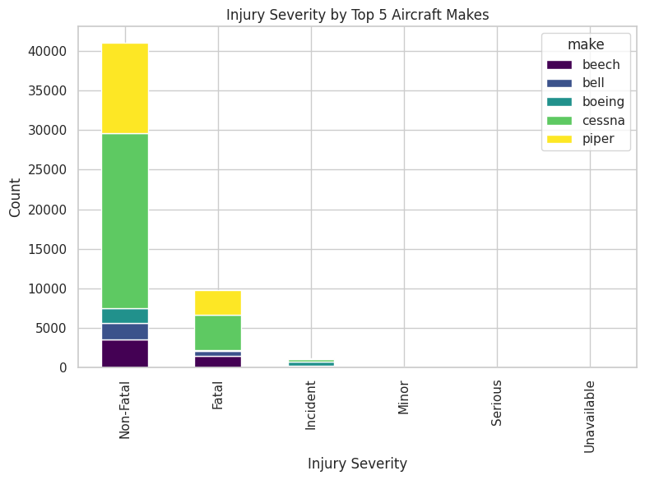
makes
Observations:
“Destroyed" aircraft are overwhelmingly associated with "Fatal" injuries.
"Substantial" damage is associated with all injury severity levels, but with a higher proportion of "Non-Fatal" and "Fatal".

Slide 10
Modeling
Approach: Built time series models to forecast accident counts from 2023 to 2027.
Models Used:
ARIMA (Autoregressive Integrated Moving Average)
Prophet (developed by Facebook for time series forecasting)

Slide 11
Evaluation
Performance: Prophet slightly outperformed ARIMA in accuracy.
Forecast Result: Continued stable or slightly declining trend in yearly accident counts.
Cross-Validation (Prophet):
Horizon: 1 to 4 years
MAE range: 31.7 to 156.9
RMSE range: 31.7 to 159.8
Model | MAE | RMSE
ARIMA | 89.21 | 112.48
Prophet | 79.96 | 100.41

Slide 12

Conclusions
Improved Planning: Allows aviation authorities to plan safety campaigns and budget resources.
Risk Management: Helps airlines and airports assess operational risks.
Policy Development: Supports evidence-based safety regulations.

Slide 13
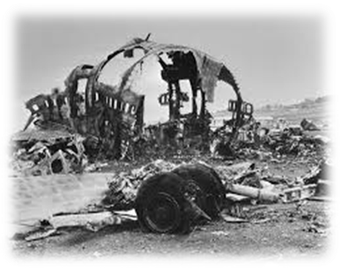
Recommendations
Update forecasts annually with new data.
Integrate external factors like weather, air traffic volume.
Use findings to inform pilot training, emergency response drills, and airport safety reviews.

Slide 14
THANK YOU
Kenneth Nyangweso
kennethnyangweso99@gmail.com
https://github.com/kennethnyangweso/Project-Analysis-on-Aviation-Accidents

